Slide 1
EXHAUST VALVE ROTATORY MOTION

Slide 2
VALVE ROTATION
Spinner or valve rotator is fitted to exhaust valve stern to rotate the valve during operation particularly in diesels engines burning residual fuel oils containing elements like vanadium and sodium.
In case any hard materials logged at a particular point between the valve and the seat, it will get repeatedly hammered forming a deep dent and allowing combustion gases to leak, there will be intense local temp rise and further damage due to erosion by high speed gas. A valve rotator may be of advantages in braking up the deposit.

Slide 3
Rotation of the valve results in even temperature distribution around sealing surface and reduces carbon build-up.
Rotation of the valve has a polishing effect removing combustion deposit between the valve and seat.
In 2-stroke engine, the hydraulically operated exhaust valve is provided with winged part (rotor vanes/spinner) on the stem in way of the gas stream. the valve is rotated by the high-speed exhaust gas flowing past it.

Slide 4
4-Stroke auxiliary engine exhaust valves have Rotocaps instead of rotor vanes (or spinners). Rotocaps act at opening time of the valve while rotor vanes act at the closing time.

Slide 5
2. ROTOCAP
The rotocap is a mechanical means to rotate a valve during operation.
Usually fitted to exhaust valves, rotation of the valve ensures that the valve is kept at an even temperature, so it does not distort and leak by, and it helps dislodge any build-up of deposits on the valve and seat.

Slide 6
The valve cover has a number of inclined tracks machined into it, each containing a ball and spring. The balls run on a race; When the valve is closed, the belville washer locks the valve cover and spring carrier together, preventing rotation, and at the same time acts on the ball race, pushing it hard up against the balls, locking them halfway up the inclined track and compressing the springs.
As the valve starts to open, the increasing valve spring force causes the belville washer to flatten. The ball race no longer locks the balls in the inclined tracks and therefore the valve cover is free to move (acts in a caterpillar like motion). The valve cover now moves over the ball bearings until the balls are at the end of the inclined tracks. As the cover rotates, so does the collet and valve spindle.

Slide 7
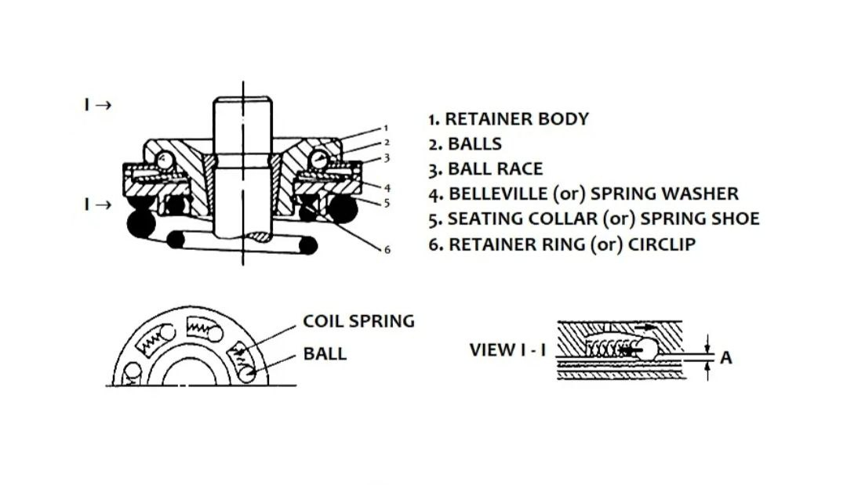

Slide 8
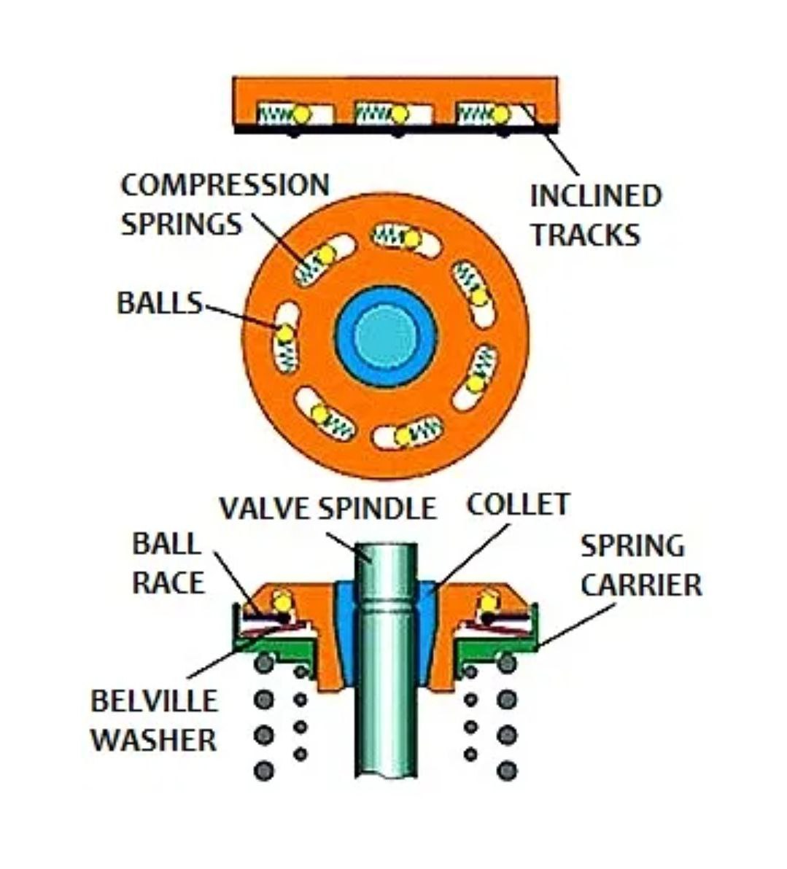

Slide 9
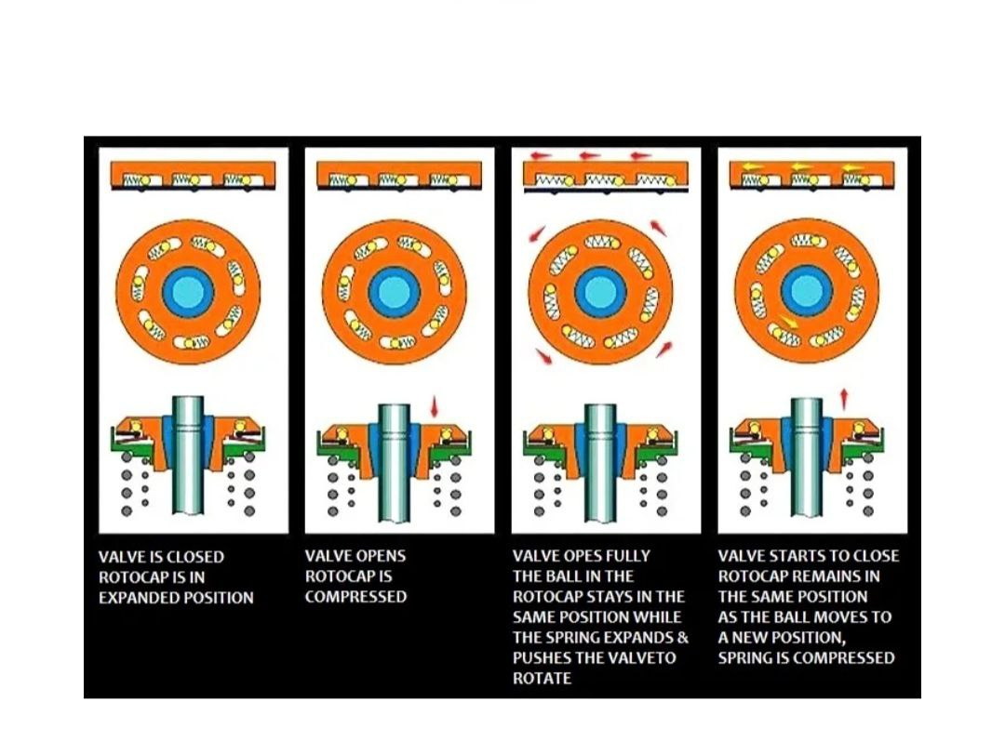

Slide 10
Rotocaps stop operating below about 25% engine load. Contaminants in the lube oil causing deposits in the inclined tracks will stop the rotocap from working. Continued operation will then cause indentations in the tracks by the balls, which will render the rotocap beyond repair.
It is normal to mark the top of the rotocap with a blob of paint so that it can be easily seen if they have stopped rotating. If this is the case, then they should be changed as soon as possible and overhauled.

Slide 11
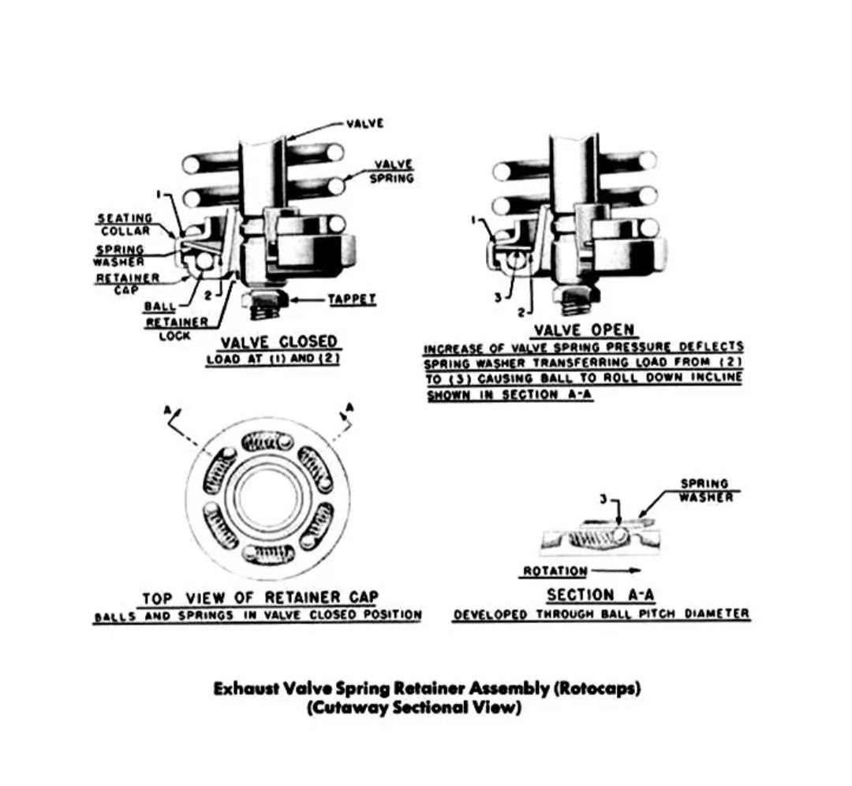

Slide 12
VALVE SPINNER (or) ROTOR VANES
Each time a valve opens, the valve rotator turns the valve slightly using the force of the exhaust gases in the same way as time turbine is rotated in the turbocharger.
This prevents the valves sticking due to carbon build up. Additionally, it allows the inlet and exhaust valves to be heated and cooled symmetrically.

Slide 13
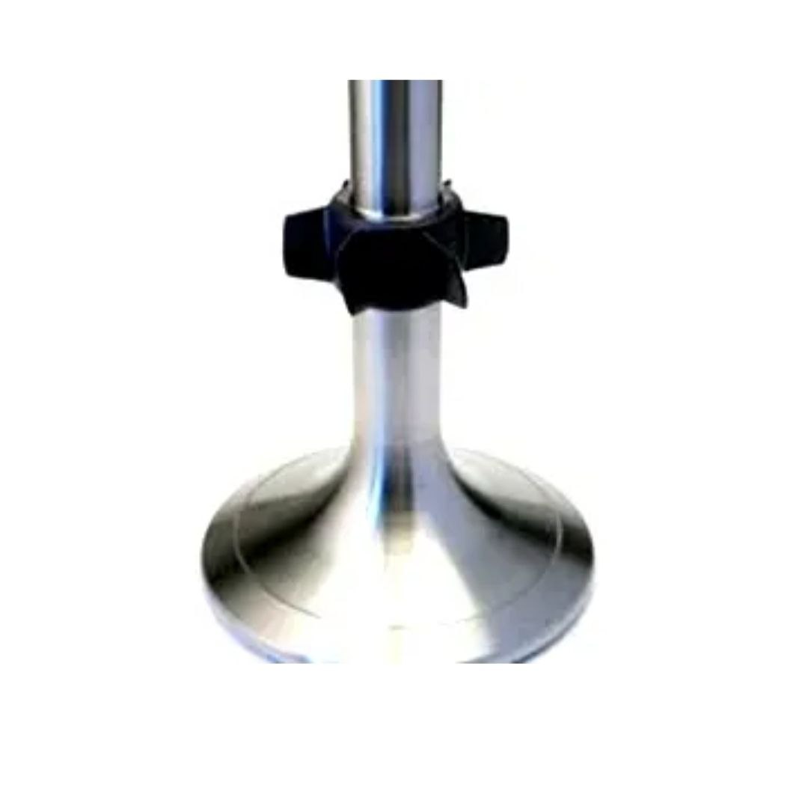

Slide 14
4. TURNOMAT
The turnomat is manufactured by Märkisches Werk, Halver or MWH for short. It is claimed to be more efficient than the rotocap because it rotates the valve as it is closing, thus removing the build up of deposits on the valve. It also operates at all engine speeds, and is not likely to stick or jam.
The main operating element consists of the spiral part which is locked by friction using collets to the valve stem. A rotation cylinder fitted with a ratchet has two balls which locate in two helical grooves machined in the spiral part. The assembly is mounted on a bearing which forms part of the spring carrier.

Slide 15
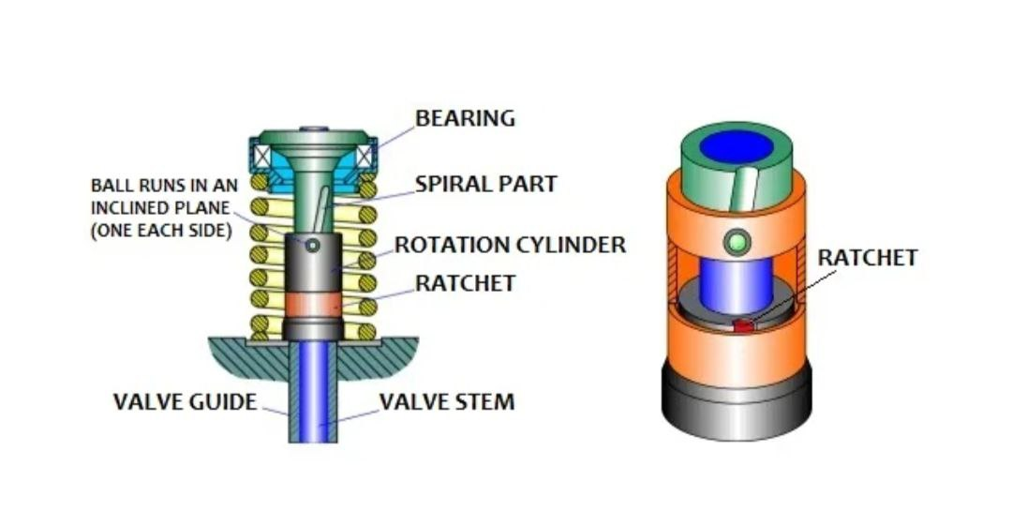

Slide 16
When the rocker gear pushes down on the valve stem to open the valve the spiral part moves downwards into the rotation cylinder. As the balls run up the helical grooves the rotation cylinder will rotate; however there will be no rotation of the valve spindle.
As the valve starts to close, the balls in the rotation cylinder move back down the helical grooves. However, the ratchet prevents the rotation cylinder from turning, and so the spiral part rotates along with the valve stem.

Slide 17
